Slide 1

Huffman Coding Problem Practical Application in Linkedin
01

Slide 2
02
Introduction
LinkedIn is a widely-used platform for professional networking and career development. It allows individuals to create profiles that highlight their skills, experiences, and career objectives. Users can connect with others in their field, join groups related to their interests, and engage in discussions. LinkedIn also offers job search functionalities, enabling users to explore employment opportunities and connect with recruiters. Whether you're looking to expand your professional network, showcase your expertise, or explore new career opportunities, LinkedIn provides a valuable platform for individuals across various industries to connect and grow.

Slide 3

03
Problem Statement
In the context of LinkedIn, where users exchange a plethora of messages containing various types of text-based content, there exists a need to optimize the transmission and storage efficiency of these messages. The current data transmission protocols may not be fully optimized for handling the vast amount of textual data exchanged between users, leading to inefficiencies in storage space utilization and network bandwidth consumption.

Slide 4
Huffman Coding
13
⁠Huffman Coding is a data compression algorithm used to encode characters based on their frequency of occurrence in a given text or data.
•⁠ ⁠Frequency-Based Encoding: Assigns shorter codes to frequently occurring characters and longer codes to less frequent ones.
•⁠ ⁠Efficient Compression: Results in efficient data compression, reducing storage and transmission requirements.
Benefits for LinkedIn:
•⁠ ⁠Space Efficiency: Huffman Coding optimizes data storage, reducing the overall space required for storing user-related information.
•⁠ ⁠Network Performance: Improves network traffic efficiency, resulting in faster data transmission and minimized bandwidth consumption.

Slide 5
EXAMPLE
In LinkedIn, Huffman coding could be utilized in compressing large text data, such as user messages or posts, to optimize storage and bandwidth usage. By encoding frequently used characters with shorter bit sequences and less frequent ones with longer ones, Huffman coding reduces the overall size of data transmission, enhancing the platform's efficiency in handling and storing user-generated content.
Recurrence Equation:
[ T(n) = 2T(n/2) + O(n*log n) ]
14

Slide 6
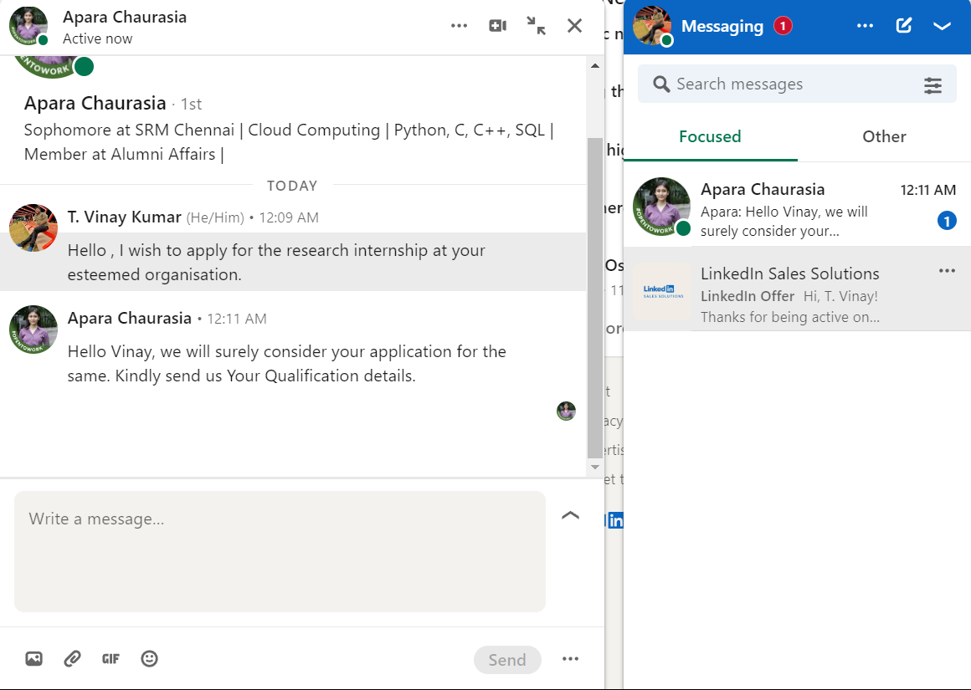
User Messaging

Slide 7
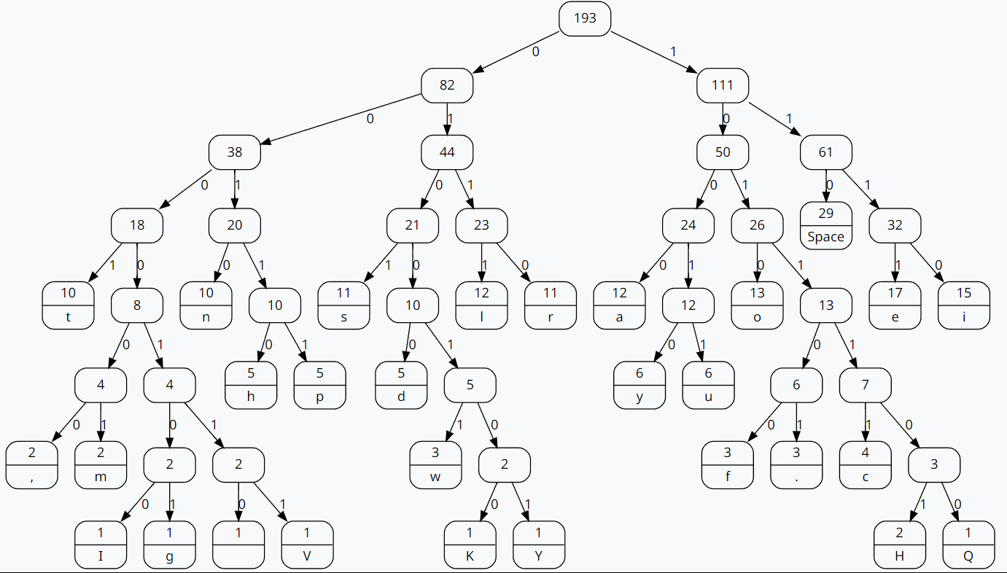
Huffman Tree Construction of the User Message
Hello , I wish to apply for the research internship at your esteemed organisation.
Hello Vinay, we will surely consider your application for the same. Kindly send us Your Qualification details.

Slide 8
Text Messages Converted into Compressed Codes
I-0000100
g-0000101
V-0000111
m-000001
t-0001
Space-110
a-1000
The Messages are thus converted into binary codes which compresses the size of the message

Slide 9
Time Complexity
Worst Case: O(n log n) - (Constructing Huffman Tree)
Best Case: O(n log n)
Building the Frequency Table:
This step involves scanning through the input data to count the frequency of each character.
The time complexity for this step is O(n), where n is the size of the input data.
Building the Huffman Tree:
Creating each node and inserting it into the min-heap takes O(log n) time, where n is the number of nodes in the heap.
Each time we extract the minimum frequency nodes from the heap, it takes O(log n) time.
As we have to perform these operations for each character, the overall time complexity for building the Huffman tree is O(n log n).
Generating Huffman Codes:
Traverse the Huffman tree to generate codes for each character.
The time complexity for this step is O(n) because we visit each node in the tree exactly once.

Slide 10

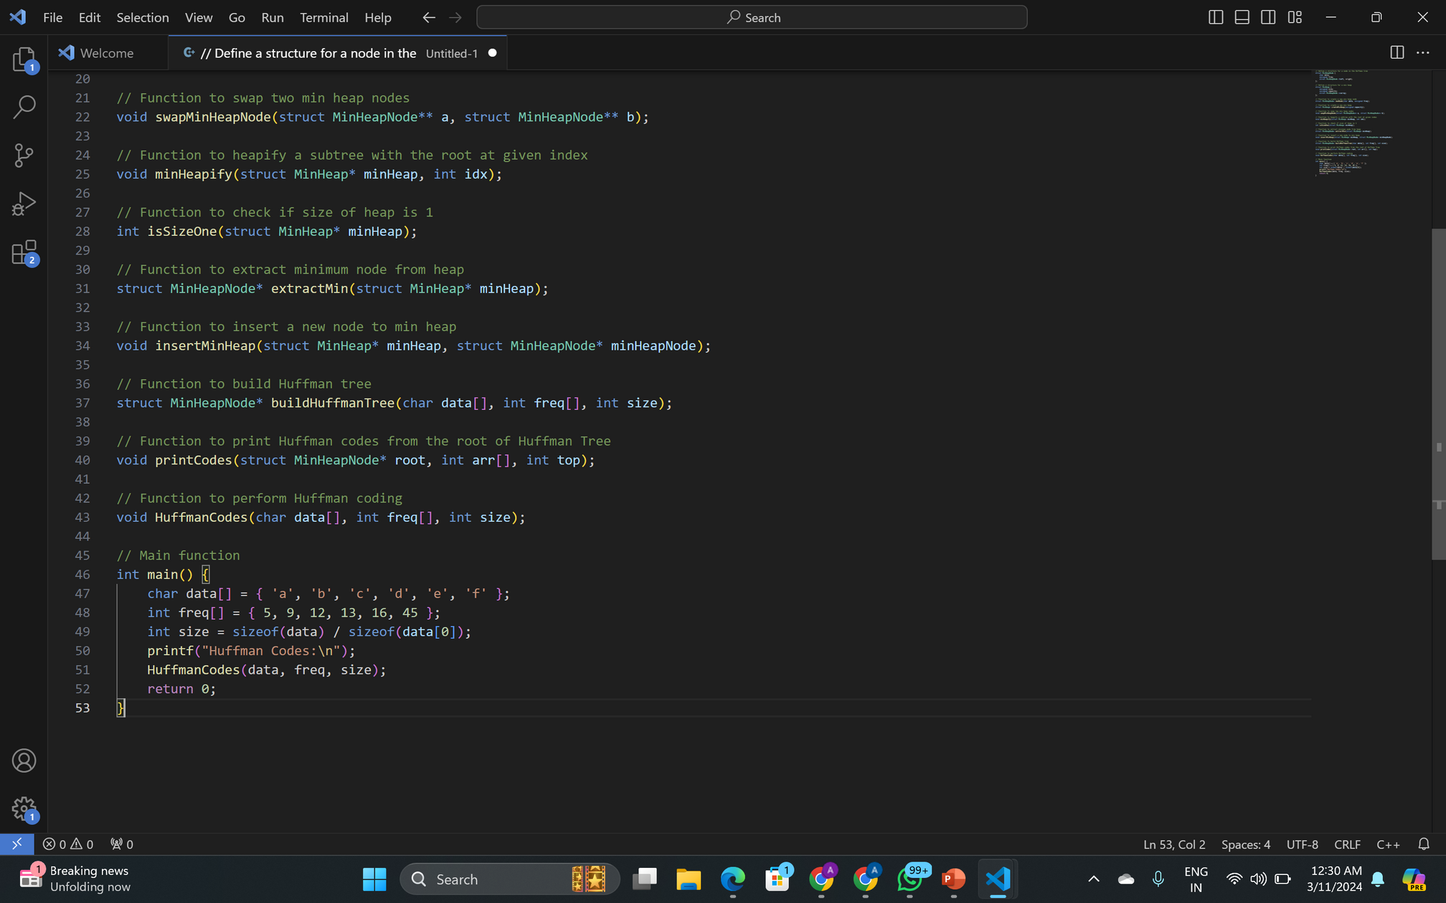
Huffman Coding Pseudocode

Slide 11
Thank You

